Slide 1
Case Study: Forest Fire Trends in India (Multi-Year Analysis by State)

Slide 2
Background :
Forest fires are a significant ecological and environmental issue in India. They lead to biodiversity loss, destruction of flora and fauna, and contribute to climate change through carbon emissions. Monitoring and analyzing trends in forest fire data is crucial for early warning systems, policy-making, and regional planning. This case study analyzes forest fire incidents report across Indian states and union territories from 2021 to 2023 based on data provided in the Excel file.

Slide 3
Objectives:
To analyze the trend of forest fires over the past three years.
To identify states with the highest forest fire occurrences.
To evaluate regional patterns and derive insights for forest fire mitigation.

Slide 4
Key Observations:
Yearly Trend The total number of forest fires varies significantly across the years. Some years show spikes, possibly due to climate conditions or human activities.
Top Affected States States like Madhya Pradesh, Chhattisgarh, and Odisha show consistently high fire incidents, indicating a need for focused preventive measures.
State-wise Trends Some states show increasing trends, while others fluctuate. These variations may be linked to changing forest density, weather patterns, and management strategies.
Heatmap Analysis The heatmap reveals seasonal and regional patterns in forest fire occurrences, helping identify peak months and vulnerable states.

Slide 5
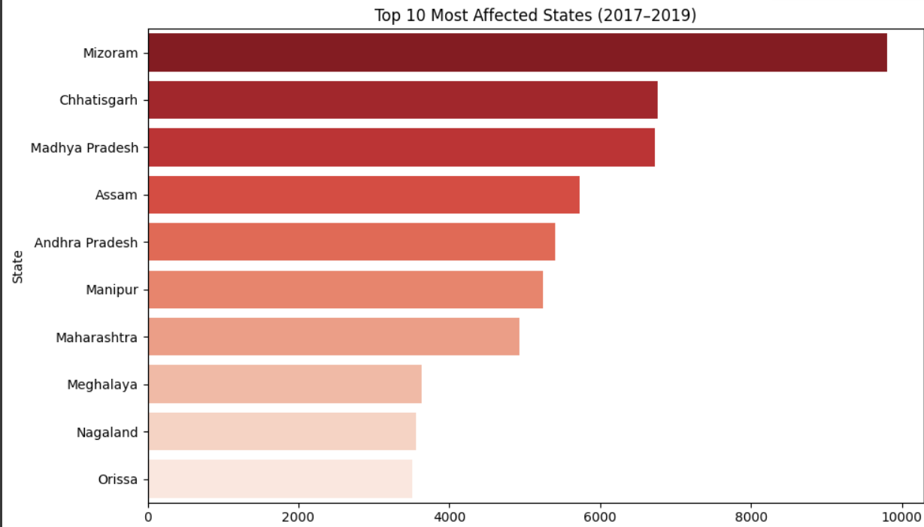
The bar chart shows the top 10 Indian states most affected by forest fires from 2017 to 2019. Mizoram recorded the highest number of incidents, followed by Chhattisgarh and Madhya Pradesh. Other states like Assam, Andhra Pradesh, and Maharashtra also reported high fire counts. A red gradient is used to highlight the severity, with darker shades indicating more fire incidents. This data reflects regions that need urgent attention for forest fire management.

Slide 6
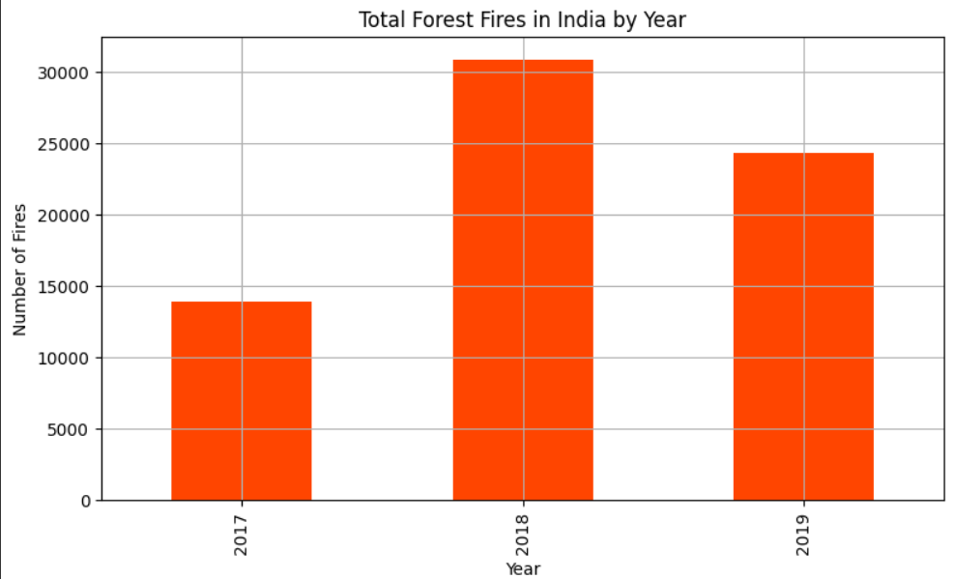
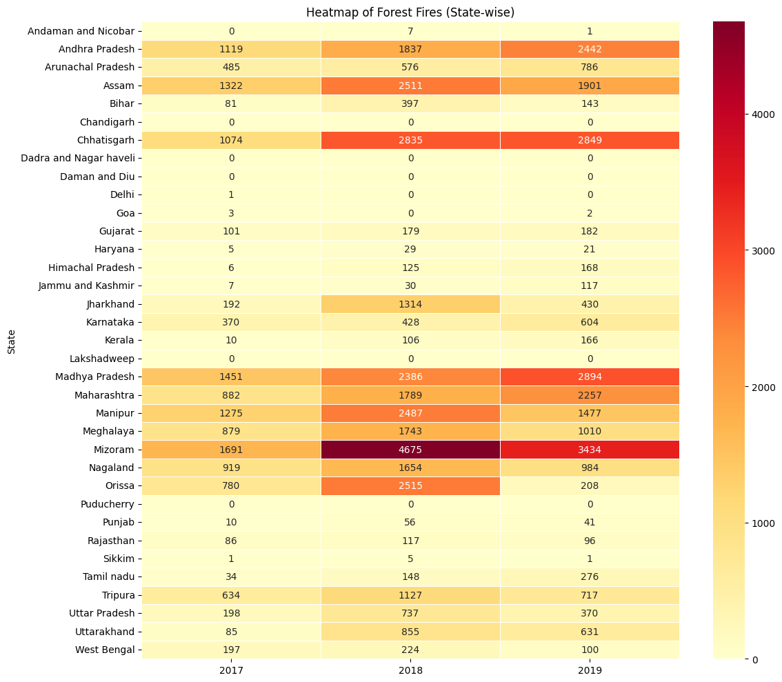

Slide 7
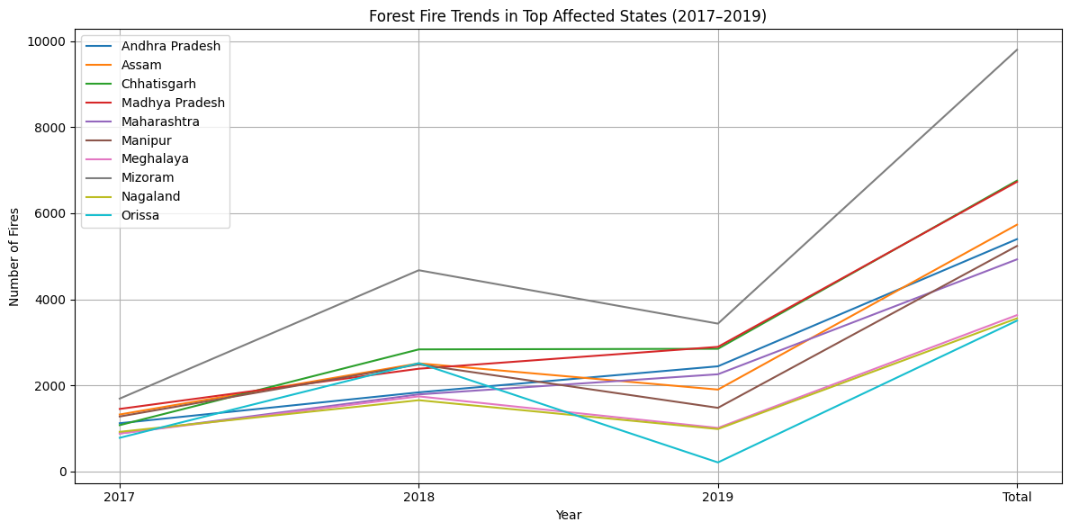

Slide 8
Solutions & Preventive Measures for Forest Fires
🔥 1. Early Detection and Monitoring
Use satellite imagery and drones for real-time fire tracking.
Install forest fire alert systems (like the Forest Survey of India’s FSI alert system).
🚫 2. Strict Control of Human Activities
Ban open burning during dry seasons.
Educate locals about the dangers of campfires and careless smoking.
Restrict entry to vulnerable forest areas during high-risk periods.
🌲 3. Forest Management
Create fire lines (clearings to stop the spread of fire).
Remove dry leaves, twigs, and inflammable debris regularly.
Promote mixed-species plantations instead of mono-culture, which burns more easily.

Slide 9
🤝 4. Community Awareness and Participation
Train local communities and forest staff in firefighting techniques.
Involve villagers in forest protection committees.
🚒 5. Rapid Response Systems
Equip local forest departments with fire extinguishers, water tankers, and fire-resistant clothing.
Set up quick-response teams for immediate action during fire outbreaks.
📜 6. Stronger Laws and Enforcement
Implement and enforce forest fire prevention laws more strictly.
Penalize illegal activities like intentional burning or timber theft that can cause fires.
🌧️ 7. Promote Rainwater Harvesting & Green Belts
Create water storage structures to help in firefighting.
Develop green firebreak zones with fire-resistant plant species.

Slide 10
Conclusion
The analysis provides a clear picture of forest fire distribution across India. The findings highlight the need for region-specific forest management policies and enhanced early warning systems. By recognizing patterns and high-risk zones, authorities can take proactive steps to reduce the damage caused by forest fires and protect biodiversity.

